Slide 1
Extended ER Model [EER]

Slide 2
EER
EER is a high-level data model that incorporates the extensions to the original ER model.
It represents the requirement of complex databases
In addition to ER model concepts EE-R includes:
Subclasses and Super classes.
Specialization and Generalization.
Category or union type.
Aggregation

Slide 3
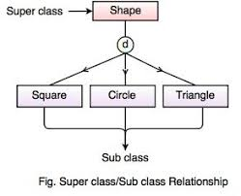
Subclasses and Super class
Super class is an entity that can be divided into further subtype.
Generalized class are called superclass, Specialized class are often called as subclass
For example: consider Shape super class.
Sub classes are the group of entities with some unique attributes.
Sub class inherits the properties and attributes from super class.

Slide 4
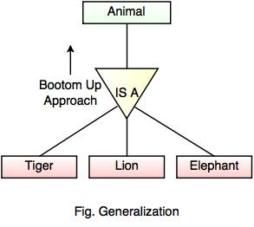
Generalization
Generalization is a process of generalizing an entity which contains generalized attributes or properties of generalized entities.
It is a Bottom up process and is the reverse process of Specialization.

Slide 5
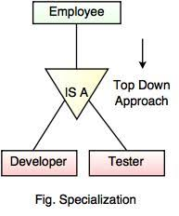
Specialization
Specialization is a process of identifying subsets of an entity that share some different characteristic.
It is a top down approach in which one entity is broken down into low level entity.

Slide 6
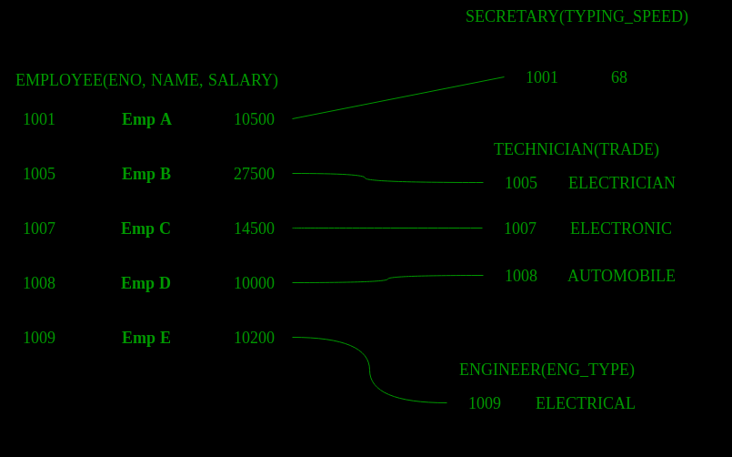
Sub-class entity “inherits” all attributes of super-class; for example employee 1001 will have attributes eno, name, salary, and typing speed.
Sub-class entity “inherits” all attributes of super-class; for example employee 1001 will have attributes eno, name, salary, and typing speed.

Slide 7
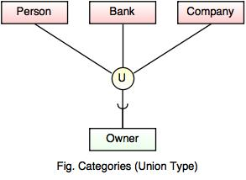
Category or Union
An entity can be sub-class of multiple entity types, ie these entities will have multiple super classes

Slide 8
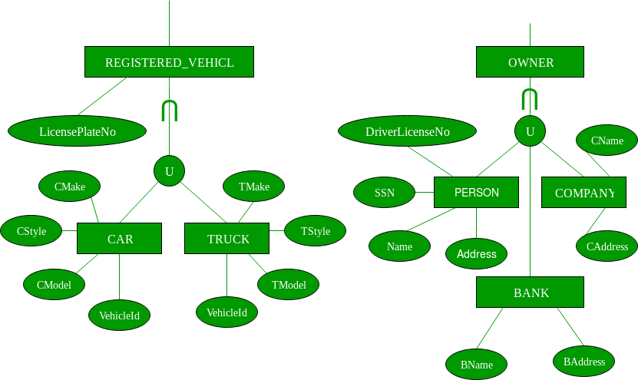

Slide 9
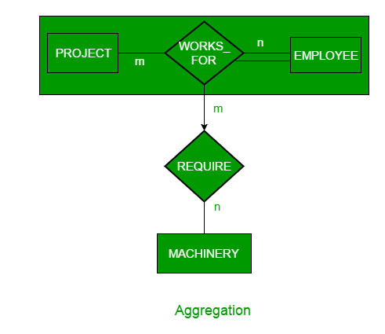
Aggregation
An ER diagram is not capable of representing relationship between an entity and a relationship which may be required in some scenarios.
It is a process when two entity is treated as a single high level entity.

Slide 10
Constraints
Total or Partial
A sub-classing relationship is total if every super-class entity is to be associated with some sub-class entity, otherwise partial.
Overlapped or Disjoint
If an entity from super-set can be related (can occur) in multiple sub-class sets, then it is overlapped sub-classing, otherwise disjoint.

Slide 11
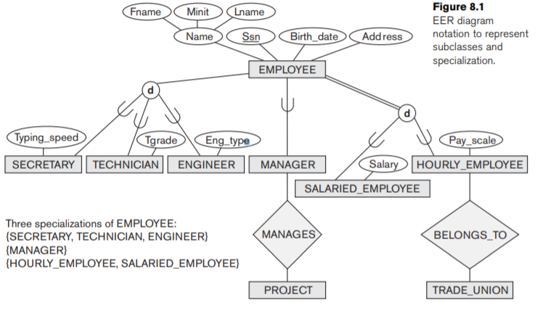

Slide 12
